Slide 1
Lec 09: Economics of Reinvention, Redesign, and Design for Manufacturing
EEE 452: Engineering Economics and Management
M. Rokonuzzaman, PhD
Zaman.rokon.bd@gmail.com
www.the-waves.org
©️Rokonuzzaman
--use is permitted only for the purpose of EEE 452 (sections 1,2,3, 4 & 5 offered at NSU in Spring 2023);no consumption and distribution is allowed for any other purpose

Slide 2
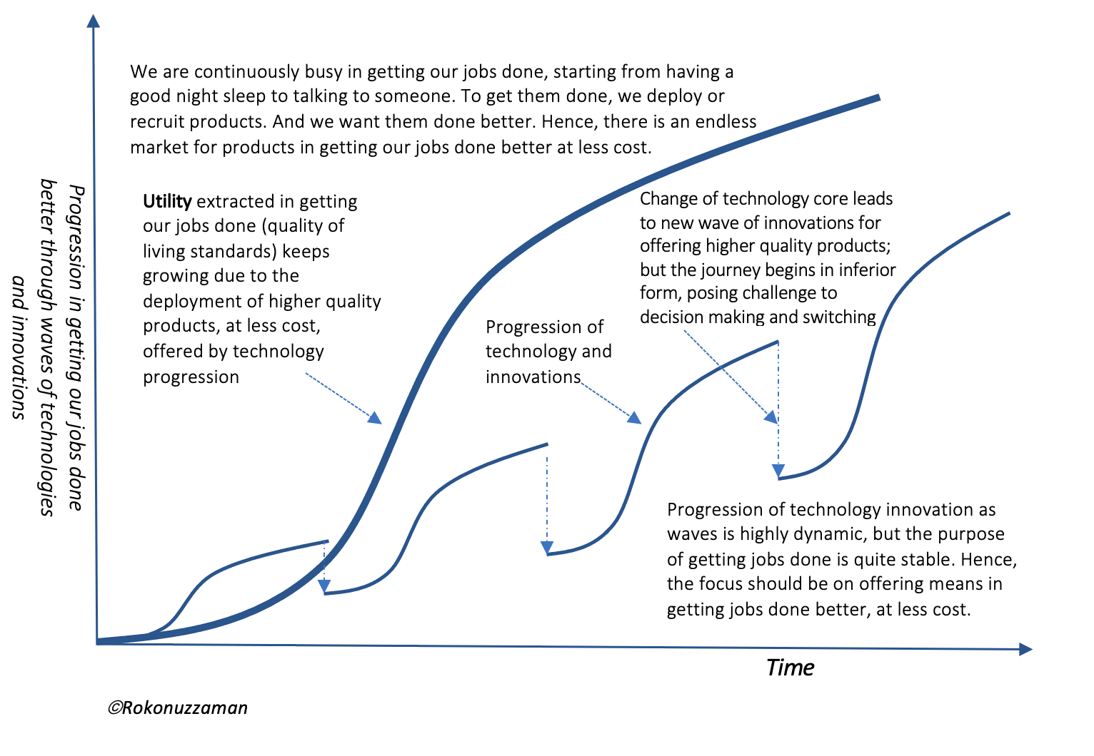
Episodic Model of Evolution of Inventions
We are after extracting increasing utility from getting our jobs done. However, the products and processes through which we use them in getting our jobs done affect the utility. Hence, to extract increasing utility, we have been after inventing technologies and advancing them so that we can offer increasingly improved products and processes.
However, advancement of technology core leads to saturation of improvement of products and process, resulting in slowing down advancement of utility extraction. Fortunately, profit making incentives have been succeeding in inventing new technology—leading to reinventions of products and also processes by changing the mature technology core with emerging ones.
But, invariably, reinventions emerge in inferior form. They keep going through advancement thorough leading to causing destruction to previous mature wave. This reality makes the journey of evolution of inventions into episodic form. For example, from the light source to printing, most inventions have been progressing in episodic form.
Inventions in reality appear to have an episodic model in which period of conventual continuity through incremental advancement, where there is cumulative progress, is followed by interruption creating period of revolutionary reinvention—leading to creative destruction.

Slide 3
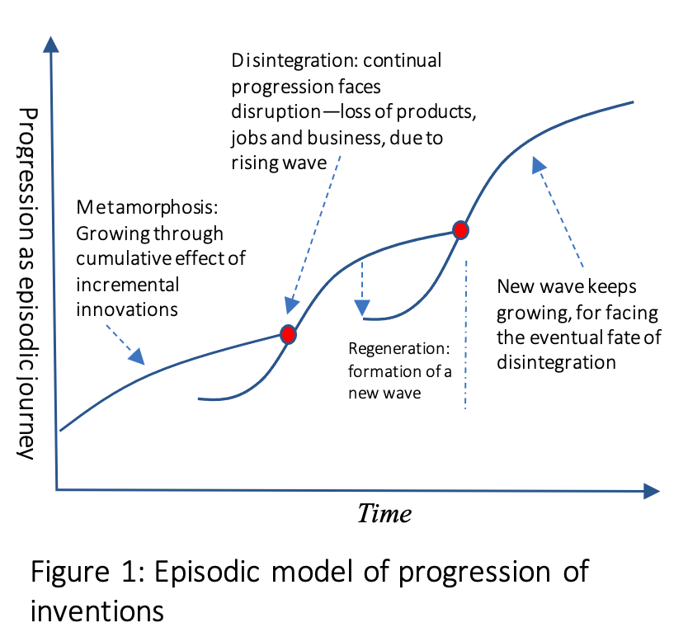
Characteristic of Episodic Model
An invention has three distinct phases: 1. Formation, 2. Metamorphosis and 3. Recreation & Disintegration. It is driven by the economics of consumption and production—for increasing both consumer and producer surpluses.
Basics of economic agenda are: i. reduce material and energy need, ii. reduce labor consumption, and iii. lowering pollution and emission. By making progress along these lines, producers succeed in offering higher quality products at decreasing price, while making increasing profit and lowering harm on the environment.
For profit making incentives, producers are after race in inventing and improving products. Government is also supportive to this race as it produces more with less for offering increasingly higher quality of living standards to growing number of people.
As inventions appear in primitive form, producers are in a race of creating cumulative effect of incremental ideas. Hence, inventions keep growing. This is about metamorphosis phase. However, this metamorphosis phase reaches saturation—slowing down or stopping progress in the agenda of economic value creation.
Hence, next phase revolutionary phase starts for reinventing products by changing the technology core. However, the reinvention begins in inferior form—demanding the repetition of the metamorphosis phase. Once this new wave reaches the inflection point, mature wave suffers from disintegration as new wave becomes a better alternative.

Slide 4
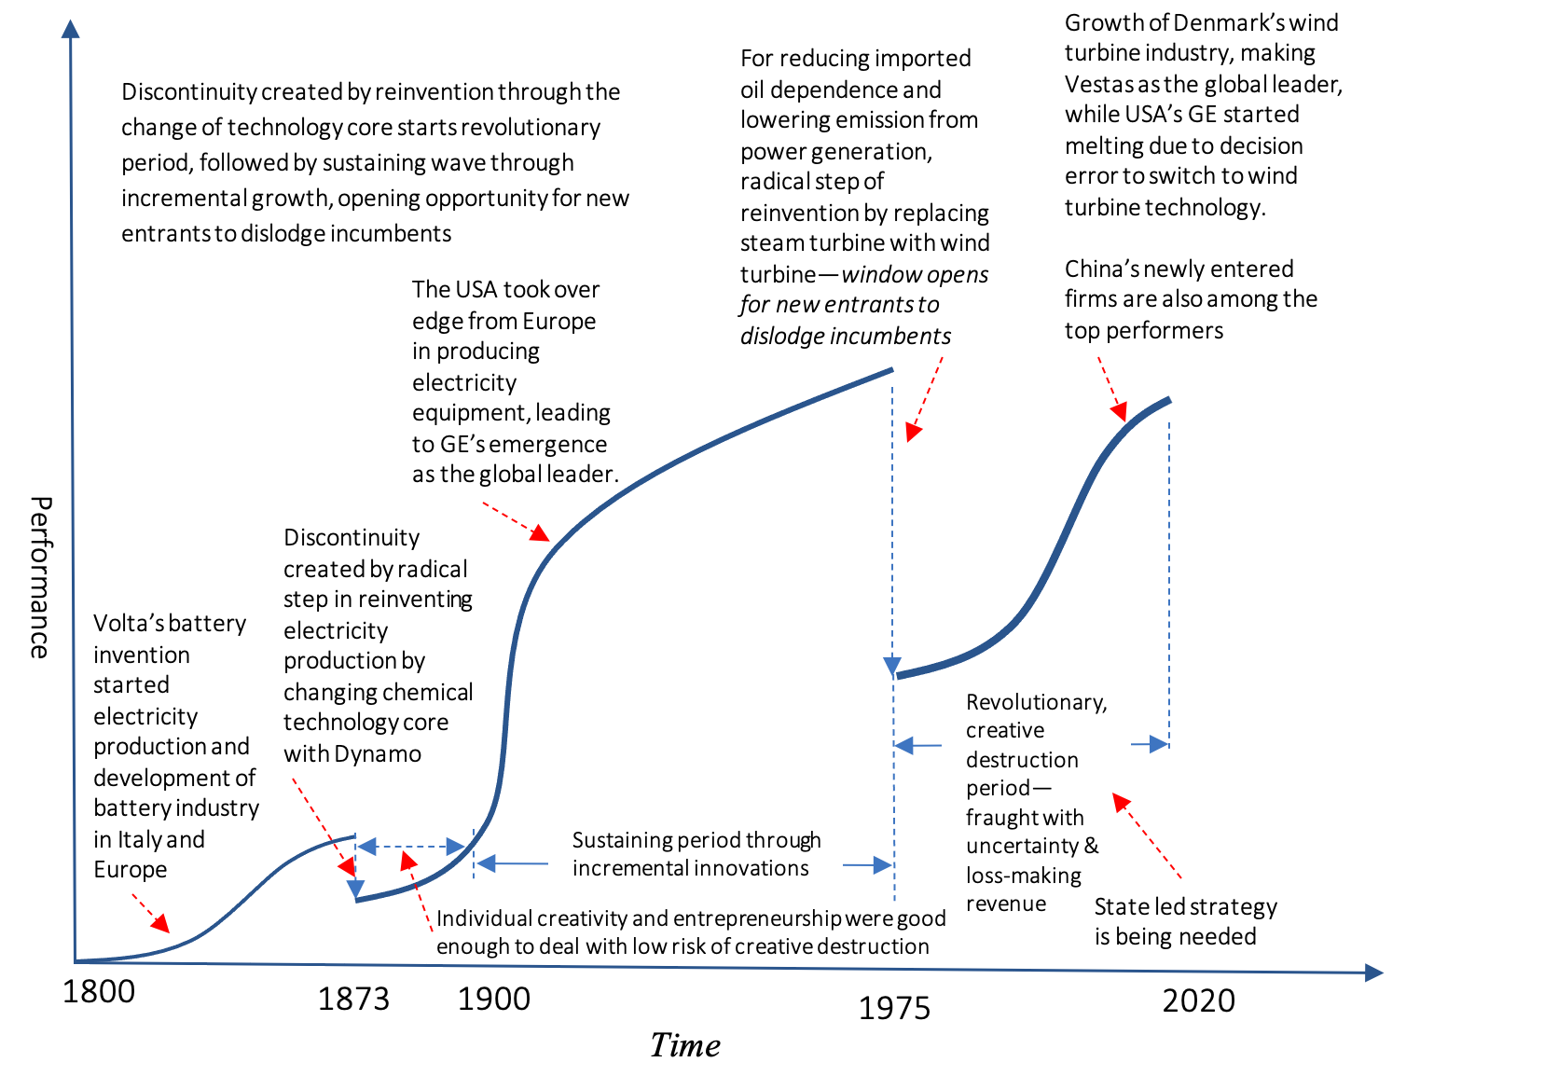
Example of Episodic Model: Evolution of Power Generation
The electric power generation started with the invention of battery by Alessandro Giuseppe Antonio Anastasio Volta in 1800. The technology core was chemical reaction. With this invention Volta proved that electricity could be generated chemically and debunked the prevalent theory that electricity was generated solely by living beings.
This invention was followed by metamorphosis phase-for keep improving the technology and supporting battery innovations. It became the source of energy for powering telegraph and telephone lines.
However, it reached saturation and became inadequate to power Edison’s light bulb. Hence, Edison, Tesla and other took the dive to reinvent electrical power generation by changing chemical technology core with dynamo. Subsequently, it has been going through another reinvention—by changing fossil fuel generated steam with wind in rotating the shaft of dynamo.
Hence, the evolution of the means of electric power generation has taken an episodic form.

Slide 5
Technology Cores for Powering Episodic Model
Technology core has been the corner stone of pursuing inventions and reinvention.
It’s true that many of the technology cores have root in intuitive ideation and tinkering in the past. For example, modern wind turbine’s technology core has root in the preindustrial era. But they were not scalable due to limited supply of knowledge. In modern time, however, they have become highly amenable to progression due to far higher flow of knowledge produced from scientific investigations. They have also been benefitting from optimum application of science through engineering, as opposed to craftsmanship, in implementation. Hence, the combination of science and engineering has been extending the economic value creation capability of technology cores.
Scientific investigations have become critical to invent technology cores to replace maturing ones. For example, personal computer technology has been highly valuable to reinvent document composing buy changing the typewriter mechanical technology core with software. Similarly, lithium-ion technology is a highly powerful technology core for reinventing battery.
However, all technology cores emerge in primitive forms—offering very little or no economic value. Hence, we need a flow of knowledge from scientific investigation to feed our creative process to generate ideas for their advancement in producing increasing economic value.

Slide 6
Formation of Creative Waves --Plunging into Reinvention
Four major causes may trigger the new wave. They are i. intense desire, ii. survival threat, iii. aggressive entry dive, and iv. high barrier to business expansion.
For example, Edison had an intense desire in experimenting with ideas, often, forming new technology core. His invention of Phonograph was the outcome of such an intense desire. The next one is the survival threat. For example, upon making initial success out of text interface based DOS, Microsoft felt impending threat from the graphical user interface based Mac.
Hence, Microsoft plunged into the revolution to recreate PC operating system by changing the text based user interface with GUI—giving birth to Microsoft Windows. On the other hand, Sony felt extreme pressure to make an entry in the consumer electronics industry. This led to the dive of reinventing Radio and TV by changing the Vacuumed tube technology core with Transistor. Similarly, due to oil shock, Denmark Government felt an extreme urge of reinventing power generation by forming a new wave around wind turbine.
High barrier to business expansion is also a driver of getting into the revolutionary step of forming a new wave. For example, in the 1940s, AT&T faced high limitation from electro-mechanical telephone switching technology core. To overcome the limitation posed by this technology core on quality and cost, AT&T sponsored R&D to invent solid state switch—leading to the invention of Transistor and formation of a new wave.

Slide 7
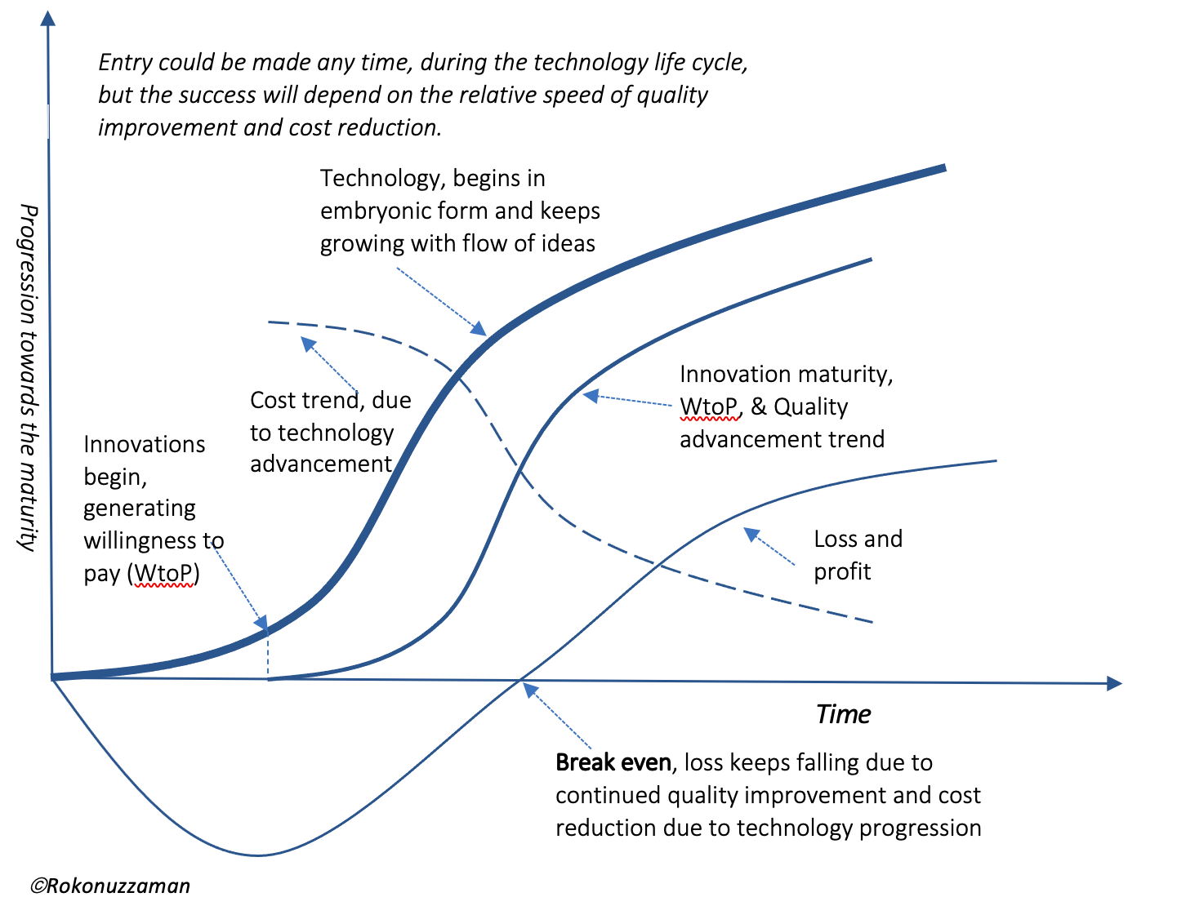
Economics of Redesign Redesign for Improving Quality and Reducing Cost by leveraging Technology Progression
All products have been evolving in helping getting jobs done better. The evolution has two major phases—i. Reinvention, and ii. Metamorphosis through a series of redesign. Each redesign leads to release of next version—better and also cheaper. Advancement of underlying technology core is one of the major drivers of this redesign. Increasing knowledge about consumer preferences, and purposes being served also leads to redesign ideas, whether as new features or advancement of existing ones.
Form the economics perspective, purpose of redesign is to keep expanding consumer and producer surpluses. Furthermore, redesign exercise also leads to efficiency innovation, leading to less harm made to the environment.
Once a product is developed, the journey of redesign begins. There are two major purposes of redesign: 1. Incremental or sustaining innovation—redesign for adding and/or improving existing features, and 2. Redesign for reducing the cost as well as improving the quality.

Slide 8
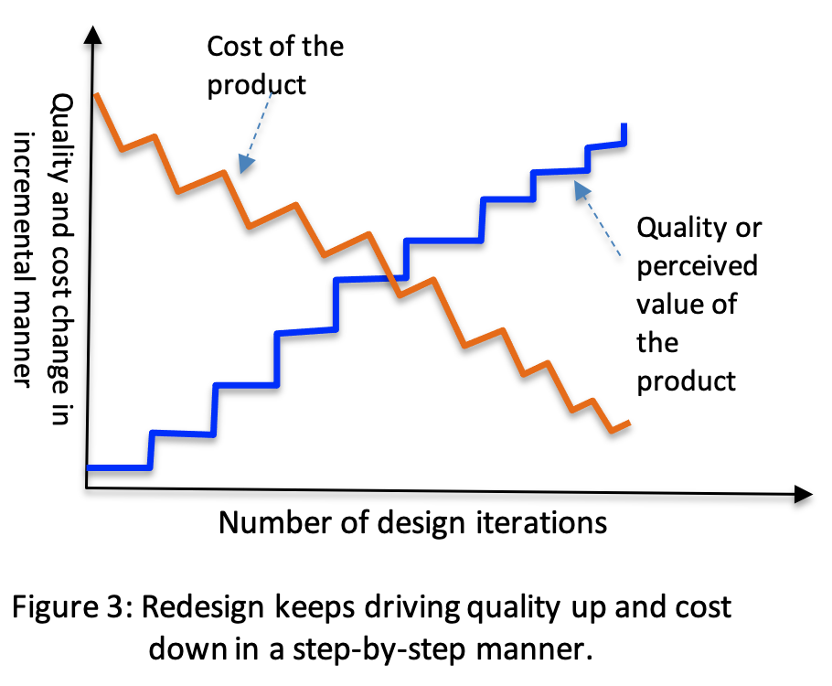
Iterative Progression of Redesign
At each iteration of redesign, the purpose is to improve the quality and reduce the cost in an incremental manner as shown in Fig. 3.
Such redesign exercise could be part of sustaining as well as efficiency (or process) innovation strategy. In the language of Dr. Jim Colins, it could be a journey of making a Good product Great, through a series of stepwise improvement.
Redesign also offers tools to foster an organization's ability to systematically create and capture "blue oceans"— offering value innovation through the simultaneous pursuit of differentiation and low cost. The redesign exercise aids in eliminating the trade-off between differentiation and low cost within a company. For sustaining a product in competitive market economy, this redesign capability is vital for meeting the demand of successive better versions, preferable at lower cost.

Slide 9
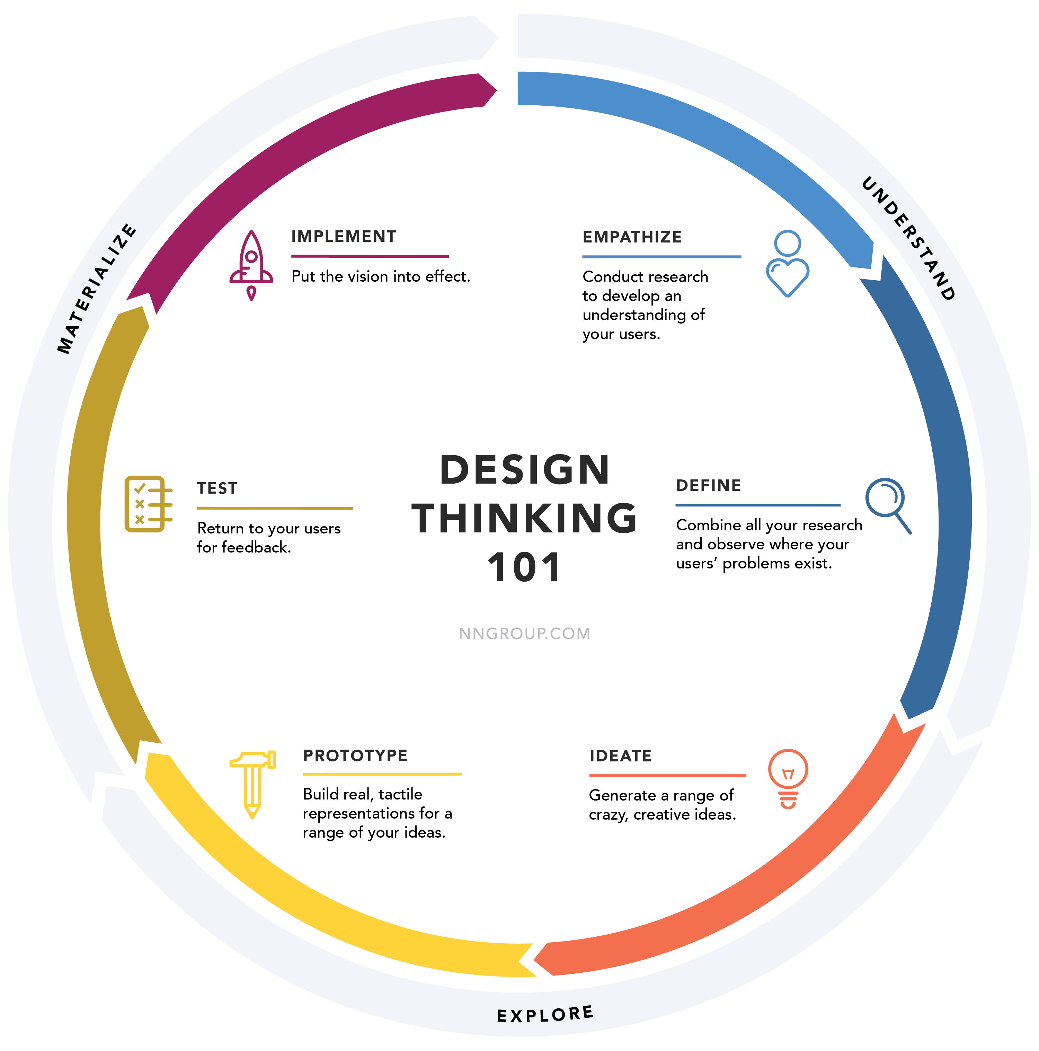
Design Thinking for Ideas of Redesign (Redesign Thinking)
Redesign options should be exercised by leveraging design thinking approach as much as possible. Design economics seriously depends on the customer preferences, which often creates uncertainty in taking design decisions.
To overcome the uncertainty of customer preferences, the various stages of design thinking should be understood as different modes, which contribute to the entire design.
The ultimate goal throughout is to derive an in-depth understanding of the product and its users as much as possible. Here is a 5-stage iterative process of design thinking proposed by Stanford University’s d.School.
Stage 1: Empathize—Research Your Users' Needs
Stage 2: Define—State Your Users' Needs and Problems
Stage 3: Ideate—Challenge Assumptions and Create Ideas
Stage 4: Prototype—Start to Create Solutions
Stage 5: Test—Try Your Solutions Out

Slide 10
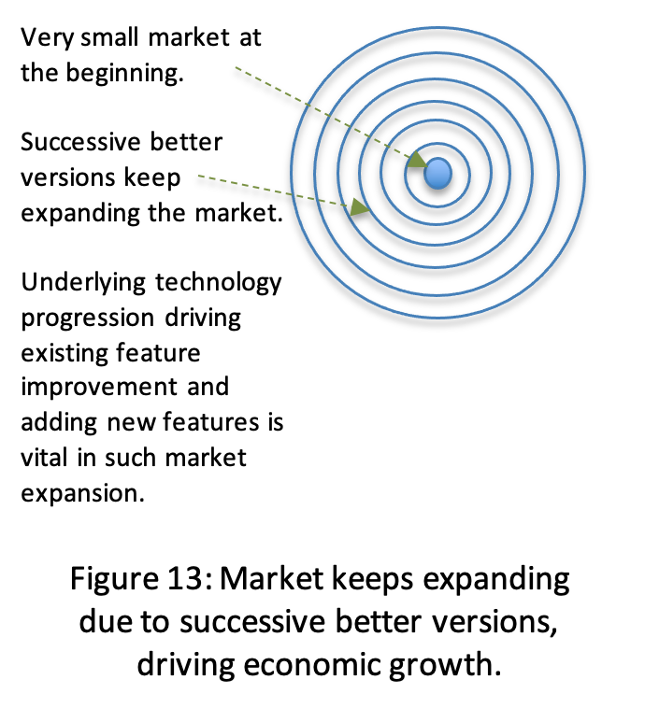
Market Keeps Expanding due to Redesigns
Irrespective of the greatness of the idea and potential strength of the underlying technology core, innovation emerges in primitive form. Such primitive product creates very little willingness to pay among a small group of customers. Even at loss, innovators succeed to sale to among a few people only.
For example, automobile has been a great innovation. In contrary to 6m+ car sale in 2017, German automakers succeeded to sale just 900 cars in 1901.
Over the last more than a century, automakers have been increasing the utility, and also reducing the cost for each unit of utility. As a result, increasing utility is being offered at diminishing per unit of utility price, resulting in growing sale and profit. Such capability of innovators of offering continually better products is vital in expanding the market.
Hence, any incentive given to the industry, research establishment, and academic institutions to support development and release of subsequent better versions of whatever an economy is producing lead to long-run economic growth.

Slide 11
Systematic Ideation for Fueling Diffusion
Instead of generating a flow of ideas through a technique like brainstorming, the challenge has been in systematically generating innovative ideas. We should look into underlying patterns to overcome the challenge in systematicaly ferreting out value from ideas. A disciplined process like discovery, scoping, feasibility, development, validation, and launch is helpful in selecting ideas.
To make the innovation appealing, innovators add new features and improve existing ones. Subsequently, an improved version is released, making it better—and also preferably cheaper. The adoption pattern will also form a wavelet. The response of the competition also has an effect on the nature of diffusion of the innovation. Due to the release of replication, imitation, and innovation, willingness to pay for innovation is a function of time. Hence, innovators keep releasing successive better versions. If those better versions are strong enough to sustain the competition response and leverage the externality effects, diffusion of successive better versions will keep progressing as a series of wavelets.
Wavelet form of innovation diffusion pattern of successive better version gives the impression that innovations behave like seasonal crops in the market. In addition to the advancement of core technology, complementary technologies also play a vital role in incremental innovation for releasing successive better versions. However, in time, core technology matures, and the growth trend of subsequent better versions slows down. Consequently, the unfolding of a series of wavelets of diffusion forms a history of mega wave of innovation diffusion.

Slide 12
Economics of Redesign (Design) for Manufacturing
Upon developing a new product, or better version of an existing product, the journey of redesign for manufacturing or production begins. This mission is not about adding new features or improving existing ones. It’s about to keep redesigning for reducing the cost of manufacturing. Some of the common targets are to increasing the scale, scope and externality benefit, easing the assembling complexity, reducing the recycling or disposal cost, and extending the life cycle—among others. Reducing emission as well as energy requirement to operate the product is also a subject of redesign economics. This redesign process keeps progressing in an iterative manner.
It begins with estimating the cost of current redesign. Design for Manufacturing (DFM) is an process of designing parts, components or products for ease of manufacturing with an end goal of making a better product at a lower cost. This is done by simplifying, optimizing and refining the product design. The acronym DFMA (Design for Manufacturing and Assembly) is sometimes used interchangeably with DFM.
Figure 1: Iterative process of redesign

Slide 13
Typical Cost Components—target for DFM
Some of the cost elements of manufacturing are: i. raw materials, ii. labor, iii. purchased components, iv. energy, v. supplies, vi. waste, vii. tooling, viii. information, ix. equipment, and x. services—as shown in Fig. 2. Design for manufacturing (DFM) looks for minimizing them.
Cost items could also be categorized as: Fixed and Variable costs, as explained below.
Fixed Costs – incurred in a predetermined amount, regardless of number of units produced (i.e. setting up the factory work area or cost of an injection mold)
Variable Costs – incurred in direct proportion to the number of units produced (i.e. cost of raw materials)
In manufacturing products, some of the cost items are:
(i) Component costs (parts of the product)
Parts purchased from supplier
Custom parts made in the manufacturer’s own plant or by suppliers according to the manufacturer’s design specifications
(ii) Assembly Costs, including labor, equipment, energy, & tooling
(iii) Overhead Costs (all other costs)
Support Costs (material handling, quality assurance, purchasing, shipping, receiving, facilities, etc.)
Indirect Allocations (not directly linked to a particular product but must be paid for to be in business)
Figure 2: Typical manufacturing cost of products, broken in a hierarchical fashion.

Slide 14
How to get ideas?
Feed knowledge and problems to the creative process to generate ideas
Brainstorming--Brainstorming is a group creativity technique by which efforts are made to find a conclusion for a specific problem by gathering a list of ideas spontaneously contributed by its members.
C-K theory--It defines design reasoning as a logic of expansion processes, i.e. a logic that organizes the generation of unknown objects
Lateral thinking--Lateral thinking is a manner of solving problems using an indirect and creative approach via reasoning that is not immediately obvious. It involves ideas that may not be obtainable using only traditional step-by-step logic.
Method of focal objects--Method of focal objects is technique for problem solving or creative thinking and involves synthesizing the seemingly non-matching characteristics of different objects into something new.
Morphological analysis--Morphological analysis or general morphological analysis is a method for exploring possible solutions to a multi-dimensional, non-quantified complex problem.
Systems theory--Systems theory is the interdisciplinary study of systems, which are cohesive groups of interrelated, interdependent parts that can be natural or human-made.
Trial-and-error--Trial and error is a fundamental method of problem-solving.^{[1]} It is characterized by repeated, varied attempts which are continued until success,^{[2]} or until the practicer stops trying.
Systematic Inventive Thinking— Systematic Inventive Thinking (SIT) is a thinking method developed in Israel in the mid-1990s. Derived from Genrich Altshuller’s TRIZ engineering discipline, SIT is a practical approach to creativity, innovation and problem solving,
TRIZ-- "theory of the resolution of invention-related tasks") is "a problem-solving, analysis and forecasting tool derived from the study of patterns of invention in the global patent literature". It was developed by the Soviet inventor and science-fiction author Genrich Altshuller (1926-1998) and his colleagues, beginning in 1946. In English the name is typically rendered as "the theory of inventive problem solving", and occasionally goes by the English acronym TIPS.

Slide 15
Systematic Inventive Thinking (SIT)
1. Subtraction
Remove an essential component from a product and find uses for the newly envisioned arrangement of the existing components. This abstracted arrangement is known as a "virtual product".
2. Multiplication
Add to a product a component of the same type as an existing component. The added component should be changed in some way. The 2 keywords for this tool are: 1) more and 2) different. These represent the two stages for applying the tool: 1) add more copies of something that exists in the product and 2) change those copies according to some parameter.
3. Division
Divide the product and/or its components and rearrange them to form a new product. Using this tool forces consideration of different structures, either on the level of the product/service as a whole, or on the level of an individual component. Dividing a product to many pieces gives the freedom to reconstruct it in many new ways – it increases our degrees of freedom for working with the situation.
4. Task unification
Assign a new and additional task to an existing resource. Less affluent cultures are more likely to adopt the Task Unification mindset. For example, the Bedouins use camels for a number of different tasks: transportation, currency, milk, skin for tents, shade, protection from the wind, burning faces for fuel. More affluent societies tend to jettison resources.
5. Attribute dependency
Creating and dissolving dependencies between variables of a product. Attribute dependency works with variables rather than components. Variables are easy to identify as those characteristics that can change within a product or component (e.g. color, size, material).

Slide 16
Strategic Areas for Ideas by leveraging ECC Technology Possibilities:
Replace mechanical parts with electromechanical or electronics
Reduce number of parts; pursue integration
Replace the role of hardware with software
Delegate increasing roles from human to machine, for both products and processes.
Develop a part which could be used in multiple products, for having scale advantage
Perform commonality & variation analysis and develop core components; develop higher level components around core components—leverage scope advantage
Use standard off the shelf components to maximize benefit from scale
Reduce the complexity of making, opening the opportunity of role delegation from human to machine
Make it easier for 3rd party component plugin--opening externality effect
Reduce the scope of causing errors in making as well as using the product
Reduce assembling, dismantling, repairing, and recycling complexity
Reduce the material, energy, and space need
Optimize processing steps--both for production and usages
Add or improve features for creating network externality effects—bigger is better, cheaper
Redesign for machine friendly production
Ideas of redesign for easing customer level assembling
Make parts self-aligning, securing position, and testing

Slide 17
Replace Mechanical Parts with Electromechanical or Electronics
Mechanical parts have many limitations, which could be addressed with electronic ones. For example, usually mechanical parts require large space and also consume more energy than electronic parts—affecting many economic parameters starting from cost, quality, and scale advantage.
To take advantage of it, over the last 70 years, more or less all-major industrial products have been going through the process of ideas of redesign for the replacement of mechanical ones by electronic components.
Starting from TV tuner, keyboard of mobile phone handset to speed regulator of electric fan, there have been countless examples.
There have been many great achievements due to systematic investigation in generating ideas from this area. For example, AT&T explored ideas for replacing electromechanical telephone switch with solid sate electrical device. That led to the invention of Transistor.
Even Tesla’s mission of electrical vehicle is about the reinvention of automobile by the idea of changing mechanical technology core with electrical and electronics. On the other hand, many of the incremental innovations of automobile have been the outcome of the developing and applying ideas of changing mechanical components with electronics.

Slide 18
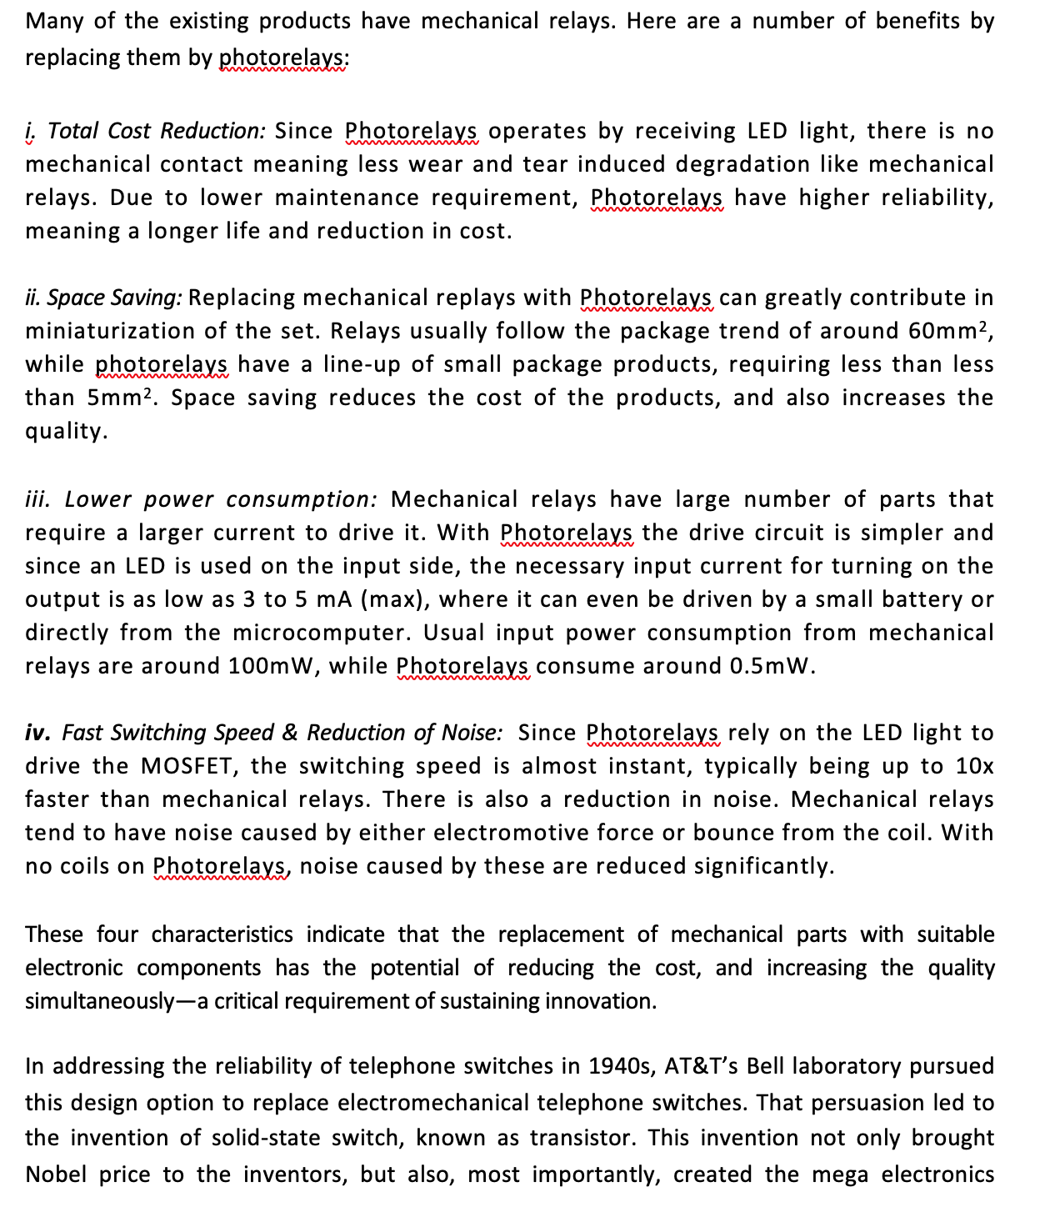
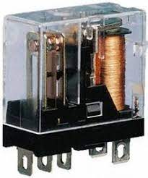
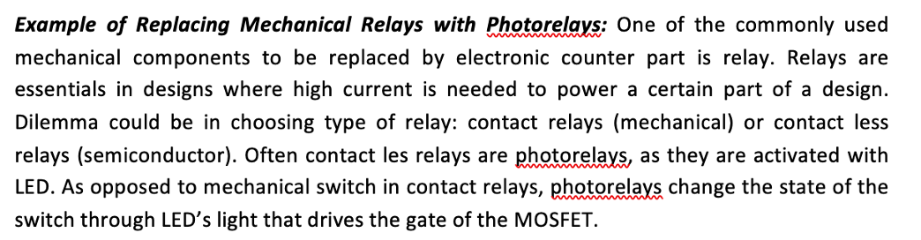
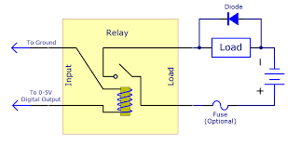
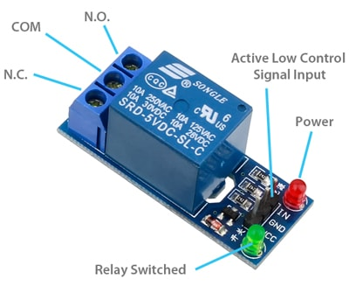
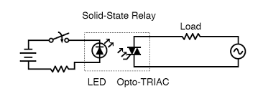

Slide 19
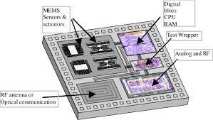
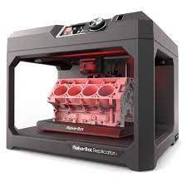
Reduce Number of Parts--pursue integration
Reduction of component count has multidimensional benefits. In one hand, it reduces space and assembling cost. On the other hand, it also reduces space requirement and energy need. As a matter of fact, the major redesign effort of electronics product has focused on integrating multiple discrete components into single one. Such redesign progress through redesign has been making many gadgets like mobile handsets and appliances like TVs more capable, and more importantly smaller as well as cheaper.
Integration of discrete electronic components into a single chip has been the driver of improvement of virtually all electronic products. Repeated application of this design option has led to LSI and VLSI chips. Replacing a printed circuit board (PCB) full of discrete parts with an application specific integrated circuit (ASIC) has always been an excellent way to reduce system and production costs.
Redesign for leveraging 3D printing for reducing number of parts is a great area of ideas. As reported in the media about GE’s success in redesigning nozzle, 'rather than 20 pieces welded together, the new tip is a single elegant piece that weighed 25 per cent less than its predecessor, and was five times more durable and 30 per cent more cost-efficient.' In addition to the fuel injecting nozzle, GE has succeeded in using additive manufacturing to make sensors, blades, heat exchangers, and other parts for jet engines. In the beginning, there is a need for high calibre engineers to build 3D printers and produce precise 3D designs of the parts, but once done, the printer starts adding layer after layer material without the need for human intervention.

Slide 20
Replace the Role of Hardware with Software
Once the roles of hardware components are replaced with software, the cost of making each copy of software component to replicate a product is virtually zero. Moreover, as software component does not wear or tear, the reliability of the product does not suffer with the aging of software components. Often the cost of developing software components to replace mechanical or electronic components is high; but once developed, due to high scale advantage, eventual cost per unit will likely be lower, provided sufficient number of the product is produced.
Moreover, software also offers scope advantage; once the core asset is developed, marginal cost of developing each component decreases substantially. Availability of low cost microcontrollers, sensors, and displays have opened significant opportunity of pursing this redesign strategy. For this reason, the density of software in major industrial products starting from automobile to microwave oven, has been increasing. Among many benefits, both assembling and recycling cost of software is zero.
Over the last several decades, many industrial products went through a series of redesign to benefit from this design option. For example, film based X-ray imaging has been replaced with sensors and software. Similarly, the role of mechanical locks is being replaced by software.

Slide 21
Delegate Roles from Human to Machine--for both making and using products
Human beings have never ending desire of reducing involvement is using industrial products. For this reason, redesigning product with reduced human role in operating them increases the utility. Often, such a progress also reduces the cost, in both producing the product and the operating as well. For example, redesign of TV with remote control features has reduced the human role in operating TVs, increasing the perceived utility. Similarly, human role in operating other commonly used industrial products such as automobiles and washing machines are being continually reduced. Over the last 50 years, starting from adaptive cruise control to motor driven window glass winding, a number of features are either being added or updated in automobiles in increasing the perceived value. This trend has been continuing in developing autonomous driving capacity.
In redesigning products for reducing human role while increasing the perceived utility, often contemporary design thinking plays a vital role. Re-framing the human-machine interface in human-centric ways appears to be extremely useful in reducing human role, while increasing the utility of the product. Understanding five stages of Design Thinking will empower us to apply the Design Thinking methods in order to solve the problem of re-designing products for reducing human role and increasing perceived utility simultaneously.

Slide 22
Develop a Part that could be used in Multiple Products—economies of scale
Often the scale effect is a powerful strategic approach, particularly due to increasing role of intellectual assets in components. Due to limited demand, a single product specific component development may not make good scale advantage. The focus should be on using a single component in multiple products, for expanding the scale effect in reducing the cost.
Utility of a component is created through a combination of Intellectual Assets, Materials, and Labor. As we keep producing each copy, the cost of intellectual asset gets keep getting divided by the total number. For software intensive components, scale benefit is extreme high as cost of copying software is zero.
Challenges of Software Component Reuse: In the corporate environment, the implementation of a reuse program requires a decision about when and where a capital investment is to be made. Development of reusable assets requires a capital investment and there should be a strategic decision as to whether investment will be made proactively or reactively. And this investment should be made at the beginning of developing a software business proposition targeting particular market segment in a proactive manner.
Proactive investment strategy for software reuse analyzes the target market segment, conceives product line, and defines architectures; then reusable assets are designed and implemented by taking foreseeable product variations into account.

Slide 23
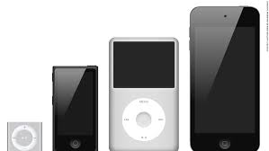
Develop Core Assets for a Family of Products—scope advantage
The exploitation of using same core component in developing higher-level components is termed as scope advantage. Using a single component in serving multiple functions is also termed as scope advantage. Scope advantage has been playing a strategic role in managing product families. Instead of designing each product from the scratch, the design strategy has been in performing commonality and variation analysis. Upon doing so, core asset is developed.
Around this core asset, multiple components (modules or sub-systems) are developed to be used in members of a product family, for leveraging economies of scope advantage. Economies of scope are "efficiencies formed by variety, not volume" (the latter concept is "economies of scale"). For example, Apple has developed multiple products around the same software core assets.
The same core software modules supported the operating systems for MacBook, iPhone and iPod mini. Similarly, automobile companies are benefiting from it by designing a family of products.
Economies of scope have the following advantages for businesses: (i) Extreme flexibility in product design and product mix; (ii) Rapid responses to changes in market.
Figure 5: Apple’s family of product design benefits from scope advantage.

Slide 24
Use standard off the Shelf Components—scale benefits
Usage of the off the shelf components often reduces the component cost, and also decreases sourcing time. Due to increasing supply of off the shelf components in compliance with applicable standards, often redesign of products in expanding the scope of using increasing number of off the shelf components reduces the cost, development time, and also reliability as well as maintainability of products.
For both software and hardware, supply of the off the shelf components has been increasing. Hence, innovators should keep exploring evolving options for pursuing ideas of redesign to keep increasing the scale advantage.
In fact, due to it, Apple sources off the shelf components even for critical modules like Camera. Often, the R&D and plant cost for high end-camera sensors reach more than $5 billion. But the marginal cost for producing each sensor is around $10. Such reality demands the leveraging of scale advantage. Even Apple encourages Sony to sell the same sensor to other competing smartphone producers so that cost per unit reaches close to the marginal cost. For this reason, making all components does not appear to be a prudent strategy. In many cases, such a strategy will increase the component cost.

Slide 25
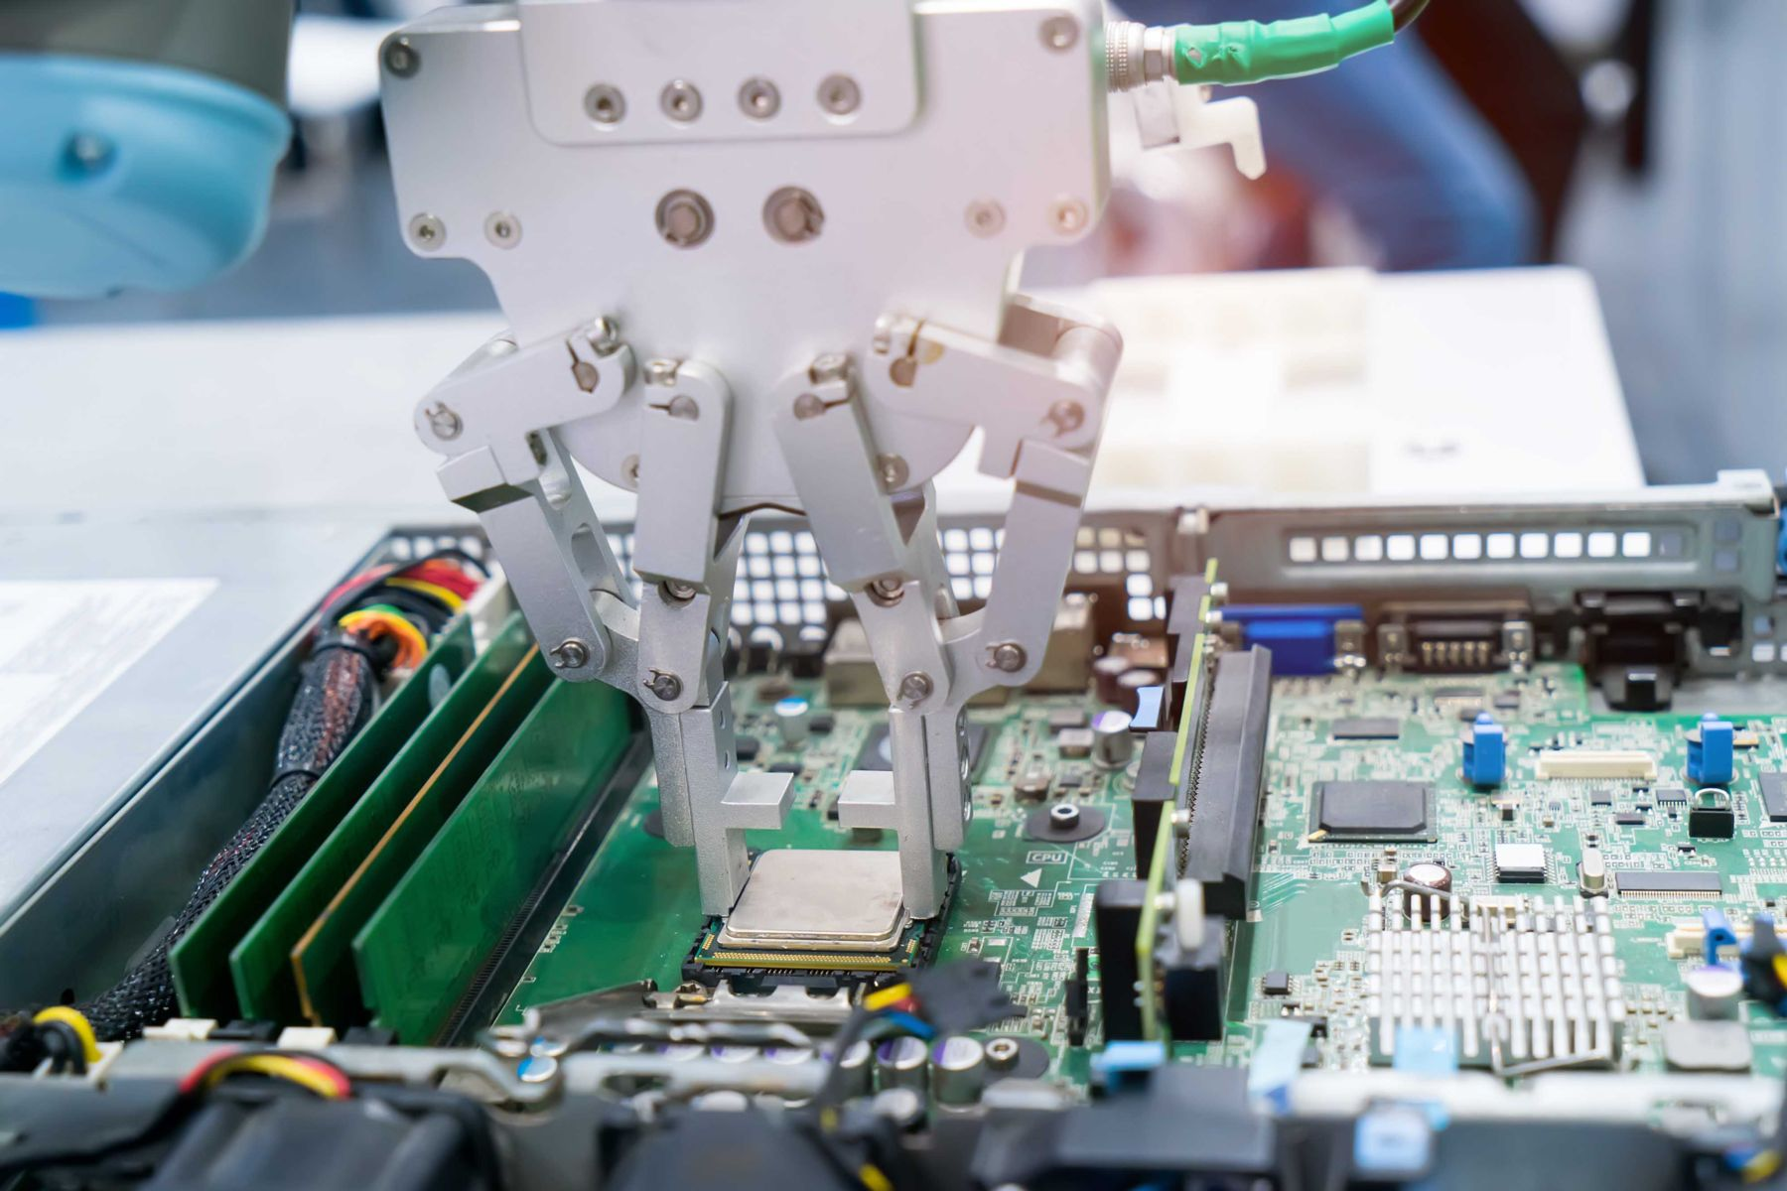
Reduce the Complexity of Making—for reducing machine time and labor
Redesign should focus on reducing the complexity of making. Along with avoiding complex motion or subjective decision-making left to human, the focus should be on reducing the requirement of movement and increasing standardization. In the short-run, this redesign approach will reduce machine time and labor requirement.
In the long-run, delegating roles to machines would be easier. Moreover, such change will also lead to higher productivity of both human workers and machines; and it will also introduce fewer errors.

Slide 26
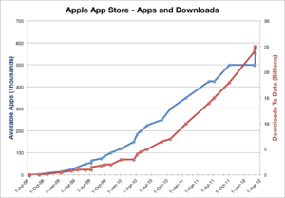
3rd Party Component Plugin--Externality Effect
To benefit from externality effect of 3rd party component plugins, product redesign should focus on either making it pluggable to other products or making other products pluggable to it.
As there has been tendency to proceed from discrete products towards system solution in performing more complex task, such redesign efforts are producing increasing returns.
For example, redesign of TVs opening the plugin options of smartphones and cameras has increased the perceived utility of both the products. On the other hand, smartphone redesigns for opening 3rd party App plug-in option has created significant positive externality effect.
Similarly, iPhone greatly benefited from the redesign to accommodate the 3rd party App plugin option.

Slide 27
Reduce the Scope of Making Errors—in both production and usages
Making errors in assembling or repairing often leads to additional cost to testing, often wastage too. Redesigning the product by leveraging human strengths as well as weakness leads to lowering chance or making errors or increasing productivity.
Moreover, such progress also demands far less skill than before in assembling and repairing products. For example, the usage of color code is often cited example. Components could be designed with intuitive as well as unique interfaces, so that confusion leading to mistakes could be avoided.
In fact, all major industrial products have been going through redesign for reducing the complexity of usages for lowering the scope of making errors.

Slide 28
Reduce Assembling, Repairing, and Recycling Complexity
The perceived value of products, particularly resale value, often depends on the ease of repairing. Repairing is usually performed using tools which are simpler than those used in manufacturing. Moreover, people having low skill often undertake the role of repairing. Therefore, the products should be redesigned in such a way that dismantling and repairing complexity keeps falling.
In order to cope up with the increasing industrial waste, particularly e-waste, there has been a regulatory concern. Products should be redesigned to reduce the complexity of recycling, so that profit-making opportunity takes care of recycling issue.

Slide 29
Reduce the Material, Energy, and Space Need
Often high-energy consumption leads to greater wastage. Such wastage not only increases energy bill, but also requires additional cost for air-conditioning. Redesign should focus on energy as well as material need to make the product better as well as cheaper. Such redesign effort will also make the product compact.
The use of efficient components as replacement of existing ones could be an option. For example, replacement of fluorescent or incandescent lamps with LED bulbs within cars, refrigerators or light fixtures will lead to lower energy cost.
Energy is consumed across all of the phases of a product life cycle with the level of energy consumed in each phase varies significantly depending on the product.
For example, in the case of electrical products the greatest contributor to environmental impact is often due to the consumption of electricity during the ‘Use’ phase, and this has been the focus of most design tools and guides. However in the majority of manufacturing applications, the production phase still represents a significant proportion of energy consumption during a product life cycle.

Slide 30
Optimize Processing Steps
In the past, to leverage job division and specialization, the focus used to be on segmenting the process of making products in large number of steps. But, as we are succeeding in delegating increasing roles from human to machines, reducing the number of steps to leverage opportunity of performing several tasks at a single workstation is reducing the cost. As a result, focus should be on optimizing number steps of processing, invariably, lowering the steps as machines have been undertaking increasing roles.
The product-manufacturing paradigm has seen profound changes during the past 100 years, as the mass production of a relatively small range of products was replaced by a job-shop type of production capable of manufacturing a large variety of products. Currently, job-shop manufacturing, in which customers select the most preferable products from a variety of products that makers prepare in advance, is giving way to a manufacturing paradigm that supports making products to order. Product redesign should take this factor into consideration.

Slide 31
Ideas for Network Externality Effects
A network effect happens when your product increases in value as the more people use it. A user's decision is based on the number of other users already using the product. Take Facebook, for example, or a mobile phone. When a user buys a phone, their decision will be based on the number and type of apps that are available on the platform.
To harness the power of network effects and scale of your product, it's important to design an effective set of features in such a way that your product creates increasing value with the growth of customers.
Direct network effects occur when the value of a product or service to your user increases exponentially with the number of the other users using the same product or service.
Indirect network effects come into play when the value of your product or service increases due to complementary products or services that add to your platform/business.

Slide 32
Redesign for Machine Friendly Production
Producibility or the ease of manufacturing a product increases the economies of scale. This often depends on the characteristics and design features of the product that enable its economical fabrication, assembly, and inspection or testing with available technologies. Producibility with automation is a growing concern as global competition to deliver products quickly and reliably reaches a frenzied pace.
Design engineers know that 85 percent of a product’s cost is determined in the design stage. So the earlier you start looking at the automated manufacturing process and how it affects your design, the better. When you make informed design decisions upfront, you reduce costs, increase efficiency, improve quality, and speed the time to market.

Slide 33
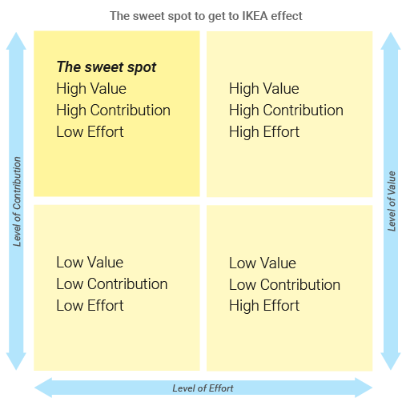
Redesign for Easing Customer Level Assembling
It has been found that delegation of some assembling roles to customers increases perceived value and reduces cost. For example, IKEA has created a huge success story by exercising this design strategy.
Instead of selling assembled furniture, requiring large delivery truck to ship to the door of individual customers, the designed strategy has been to make the assembling quite easy for the customers, without the need of high-end skill or tools. Customers can simply pick pieces of furniture in the back of family trucks, move them one by one inside the residence, and then assemble them by themselves.
Such redesign strategy appears to be highly useful in designing many products. Design for assembly (DFA) is a process by which products are designed with ease of assembly in mind. If a product contains fewer parts it will take less time to assemble, thereby reducing assembly costs. In addition, if the parts are provided with features which make it easier to grasp, move, orient and insert them, this will also reduce assembly time and assembly costs.
Figure 8: Decision matrix for detecting the sweet spot for leveraging IKEA effect.

Slide 34
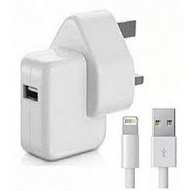
Make Parts Self-aligning, Securing Position, and Testing
Last, but not the least; this redesign strategy has multi-dimensional effects. Progress along this line will reduce errors, lower skill needs, and decrease testing time in making and also using products. Moreover, it will also ease the repairing. Accurately aligned components will always provide superior performance and longer service life than poorly aligned ones.
For example, a misaligned rolling bearing causes increased rolling friction, accelerated fatigue, shaft binding and decreased service life. Self-aligning components allow designers to achieve design intent without the costly methods required to keep components perfectly aligned. Using self-aligning components, you can relax tolerances and component constraints, and simply rely on the self-compensating features. This approach can dramatically reduce component and assembly cost. Moreover, self-aligning also increases the usability.
Figure 9: Self aligning design examples of electric power and data connectivity

